Slide 1
Usability
Usability is a quality attribute that assesses how easy user interfaces are to use. The word "usability" also refers to methods for improving ease-of-use during the design process.

Slide 2
Usability is defined by 5 quality components
Usability
Learnability
Memorability
Errors
Satisfaction
Efficiency
Notes:
2

Slide 3
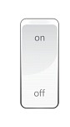
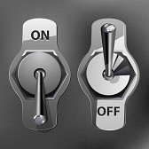
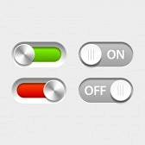
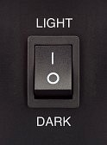


Learnability: How easy is it for users to accomplish basic tasks the first time they encounter the design?
Usability
Learnability
Memorability
Errors
Satisfaction
Efficiency

Slide 4
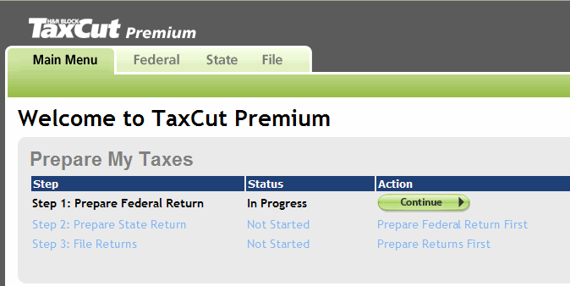
Memorability: When users return to the design after a period of not using it, how easily can they reestablish proficiency?
Usability
Learnability
Memorability
Errors
Satisfaction
Efficiency

Slide 5
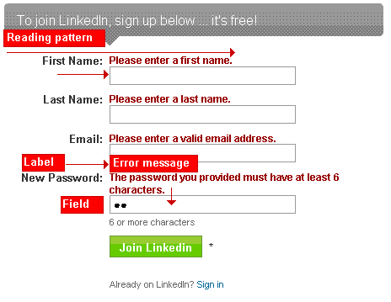
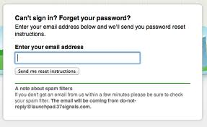
Errors: How many errors do users make, how severe are these errors, and how easily can they recover from the errors?
Usability
Learnability
Memorability
Errors
Satisfaction
Efficiency

Slide 6

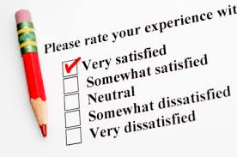
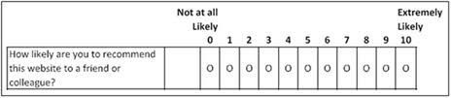
Satisfaction: How pleasant is it to use the design?
Usability
Learnability
Memorability
Errors
Satisfaction
Efficiency

Slide 7
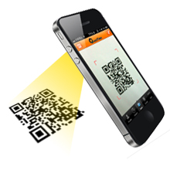

Efficiency: Once users have learned the design, how quickly can they perform tasks?
Usability
Learnability
Memorability
Errors
Satisfaction
Efficiency

