Slide 1
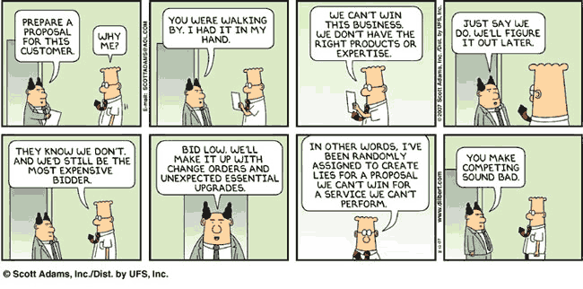
Project Proposal

Slide 2
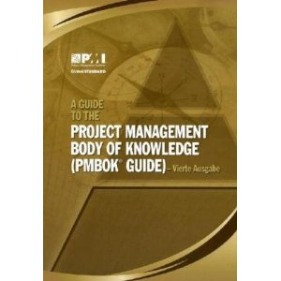
One of our guides
Project Management Institute (PMI)
Recognized by the Americans National Standard Institute (ANSI) for guidelines on project management
Project Management Body of Knowledge (PMBOK)

Slide 3
Project Initiation
Project Proposal → Project Initiation → Project Lifecycle
Project Proposal: A project proposal is generally made when the project is yet to be awarded to a performing organization; which also means more than one bidders can submit their proposals based on the Request for Proposal (RFP).
Project Charter: A project charter is a document which is more an approval by the sponsor for deployment of resources on any project, in other words, a document which is prepared once the project is awarded to a performing organization.
A project proposal sits outside the boundaries of the project management process groups and is an input (cross boundary) to the initiating process group and the creation of the project charter, which legitimizes the project and commits funds to enter the planning process group. (PMBOK)

Slide 4
Project proposal

Slide 5
Project Proposal
Purpose
The purpose of a project proposal is to determine if a proposed project is feasible, practical, and worth pursuing.
Who Writes the Proposal?
The project proposal is usually developed from discussions among key stakeholders, and is generally written by marketing personnel, a project sponsor, or a project manager.
What Should a Proposal Contain?
The project proposal should address at least the following questions, but this too depends on the corporate culture, and should be adapted accordingly.

Slide 6
1. How will this project solve a problem or meet a need?
New product projects must be based on meeting a need or solving a problem. For commercial products marketing personnel attempt to identify needs within a market segment.
In some cases, a customer may define its needs and seek a corporation that can best meet them. Another marketing strategy is to identify a problem to be solved within a market segment.
It is this need, or opportunity, that becomes the fundamental reason for considering a new product project. This aspect of the proposal should consider the following aspects:
Describe the problem to be solved or the need to be met.
Describe the factual evidence that defines the problem or need.
Verify the accuracy of the factual evidence, both qualitatively and quantitatively.

Slide 7
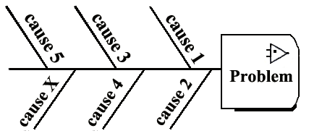
2. What is the problem?
Next, the solution to the need (or problem) is to be evaluated. How well does it meet the need? Who are the competitors, and how will the new product fit into the market window?

Slide 8
3. What is the goal?
In most cases, the problem solution becomes the goal of the project. Whenever possible, the goal should be:
Specific
Measurable
Achievable
Relevant to the corporate strategy
Time-lined

Slide 9
4. What are the product (or service) requirements?
Either marketing personnel (UX), or a customer will identify the product requirements–what the product is expected to do, and how it must perform. Requirements at this stage are embryonic and will be defined during the project planning processes. Most customers don’t know what they want until they know what you can provide.

Slide 10
5. Is this project aligned with corporate goals and strategies?
The proposed project should be evaluated against the overall strategies of the corporation to ensure that it is properly aligned with its strategic goals. Business strategies may include any one of the following:
Delayed Revenue Generation. Defer immediate return on investment in favor of generating revenue from long-term product operations and support.
Market Penetration. Saturate market at near cost value to become the dominant leader.

Slide 11
6. What is the overall scope of work required for this project?
Provide a top-level description of the overall scope of the project. At this point, not enough information is typically available to describe scope in detail. This will take place during the initial planning stage of the project. However, the general description of the project’s scope should be sufficient for making rough estimates of the project’s schedule and costs.

Slide 12
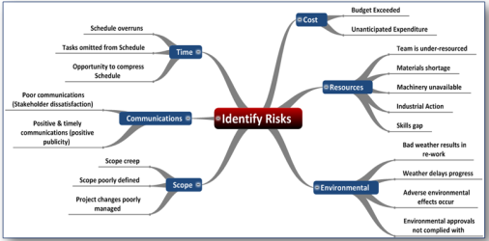
7. What obstacles and risks will this project face?
Any identifiable obstacles and risks (threats) that might prevent the successful attainment of the project goals must be considered. Each risk must be analyzed, quantified, and prioritized as much as possible with the information available at this stage of a new project.
Risk responses, including mitigations, risk sharing, risk avoidance, and risk tolerances should be described in this portion of the project proposal.

Slide 13
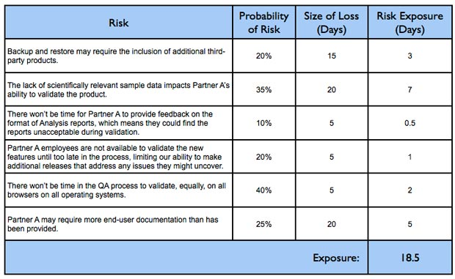
Some risk tools

Slide 14
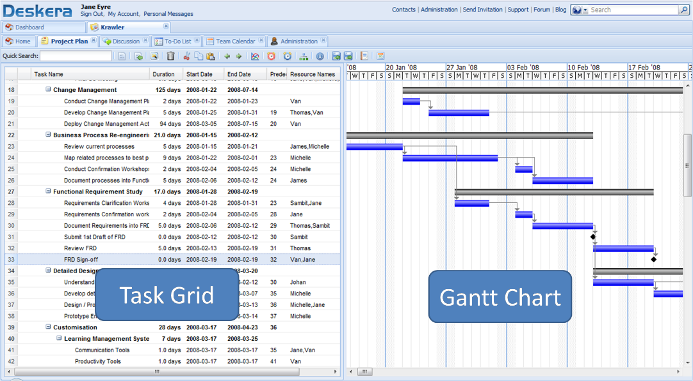
8. How long will this project take (schedule)?
Once a general product concept is established, and its requirements are proposed, an estimate of the project’s duration is to be made. Since most information at this stage is very general, only a top-level schedule duration estimate can be made, and it is usually given as a range estimate, such as “the schedule duration is estimated to be between 19 to 26 months.”

Slide 15
9. How much will this project cost?
Order of magnitude cost estimates are also made as part of the project proposal, and like the schedule estimate, are usually given as a range, such as, “the cost is estimated to be between $2.1 to $2.6 Million.” Cash flow tables, projected return-on investment, and funding requirements are also considered in this step.
Projected ROI depends on the market size, the estimated market share to be gained, and the cost per unit.

Slide 16
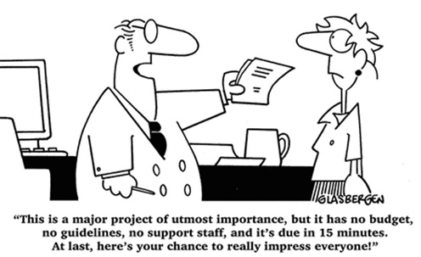
10. What resources will be required by this project?
Before a project can be authorized it is vital that a corporation consider the resources needed to support it. Resources include needed personnel, equipment, facilities, processes, and funding. Should insufficient resources be available it may be necessary to either outsource portions of the project, or reduce its scope to fall within available resources.

Slide 17
Project charter

Slide 18
Purpose of the Project Charter
Reasons for undertaking the project
Objectives and constraints of the project
Directions concerning the solution
Identities of the main stakeholders
In-scope and out-of-scope items
Risks identified early on (A risk plan should be part of the overall project management plan)
Target project benefits
High level budget and spending authority

Slide 19
Uses of the Project Charter
To authorize the project - using a comparable format, projects can be ranked and authorized by Return on Investment.
Serves as the primary sales document for the project - ranking stakeholders have a 1-2 page summary to distribute, present, and keep handy for fending off other project or operations runs at project resources.
Serves as a focal point throughout the project. For example, it is a baseline that can be used in team meetings and in change control meetings to assist with scope management.

Slide 20
Example Charters
Here are some example charters from PMI
http://search.pmi.org/default.aspx?q=project+charter

