Slide 1
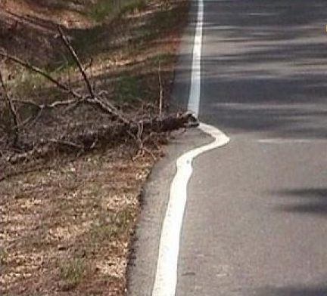
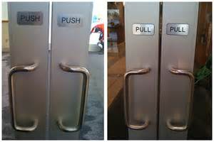
Design principles
Generalizable abstractions for thinking about different aspects of design
The do’s and don’ts of interaction design
What to provide and what not to provide at the interface
Derived from a mix of theory-based knowledge, experience and common-sense
Notes:
1

Slide 2
Design Principles:
Visibility
Feedback
Constraints
Consistency
Affordance (give a clue)
Learn more about Don Norman at
jnd.org

Slide 3
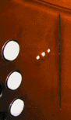
Visibility
• This is a control panel for an elevator
• How does it work?
• Push a button for the floor you want?
• Nothing happens. Push any other button? Still nothing. What do you need to do?
It is not visible as to what to do!
Notes:
3

Slide 4
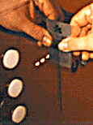
Visibility
      …you need to insert your room card in the slot by the buttons to get the elevator to work!
      How would you make this action more visible?
      make the card reader more obvious
      provide an auditory message, that says what to do (which language?)
      provide a big label next to the card reader that flashes when someone enters
      make relevant parts visible
      make what has to be done obvious
Notes:
4

Slide 5
Common visibility mistakes
Link not indicated until you hover over it
You don’t know what can be found by clicking on a link until you click on and go to that page
Items needed for earlier decisions are in an accordion menu
Items needed for earlier decisions are below the fold or off focus
5

Slide 6
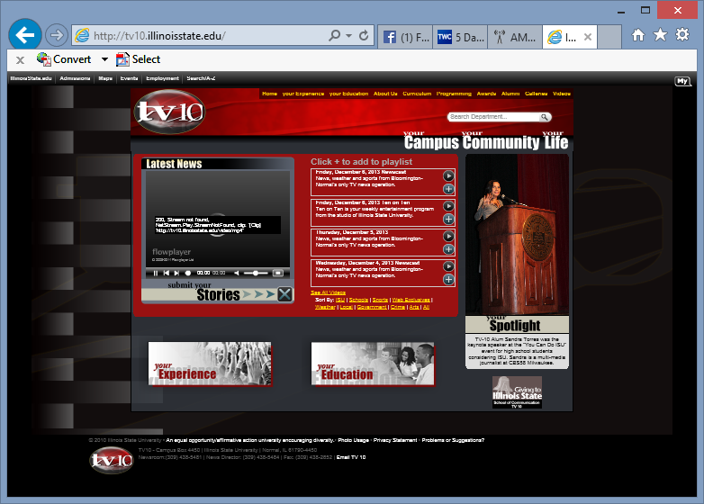
6

Slide 7
Visibility:
Invisible automatic
controls can make it
more difficult
to use
What do I do if I am
wearing black?
Notes:
7

Slide 8
Feedback
Sending information back to the user about what has been done
Includes sound, highlighting, animation and combinations of these
  e.g. when screen button clicked on provides sound or red highlight feedback:
“ccclichhk”
Notes:
8

Slide 9
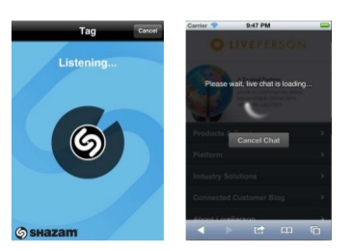
Common feedback mistake
Forgetting the confirmation page
No error message
Long page load time (did I click on that link? Hmm…maybe I had better click it again.)
9

Slide 10
Constraints
Restricting the possible actions that can be performed
Helps prevent user from selecting incorrect options
Physical objects can be designed to constrain things
  e.g. only one way you can insert a key into a lock
Notes:
10

Slide 11
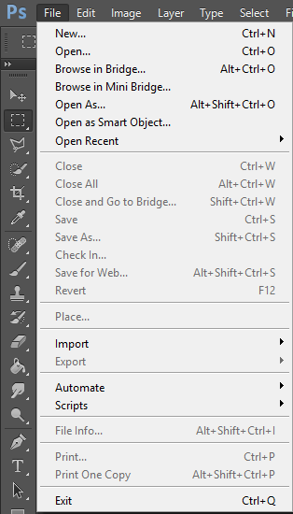
Constraint example: Greyed out items
11

Slide 12
Consistency
Design interfaces to have similar operations and use similar elements for similar tasks
For example:
  always use ctrl key plus first initial of the command for an operation – ctrl+C, ctrl+S, ctrl+O
Main benefit is consistent interfaces are easier to learn and use
Notes:
12

Slide 13
When consistency breaks down
What happens if there is more than one command starting with the same letter?
  e.g. save, spelling, select, style, or cut, copy
Have to find other initials or combinations of keys, thereby breaking the consistency rule
  e.g. ctrl+S, ctrl+Sp, ctrl+shift+L
Increases learning burden on user, making them more prone to errors
Notes:
13

Slide 14
Internal and external consistency
Internal consistency refers to designing operations to behave the same within an application
External consistency refers to designing operations, interfaces, etc., to be the same across applications and devices
Notes:
14

Slide 15
Keypad numbers layout
A case of external inconsistency
(a) phones, remote controls
(b) calculators, computer keypads
1
2
3
7
8
9
4
5
6
4
5
6
7
8
9
1
2
3
0
0
Notes:
15

Slide 16
Affordances: to give a clue
Refers to an attribute of an object that allows people to know how to use it
  e.g. a mouse button invites pushing, a door handle affords pulling
Notes:
16

Slide 17
How would you fix this?
17

Slide 18
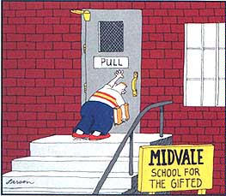
Midvale School for the Gifted
18

Slide 19
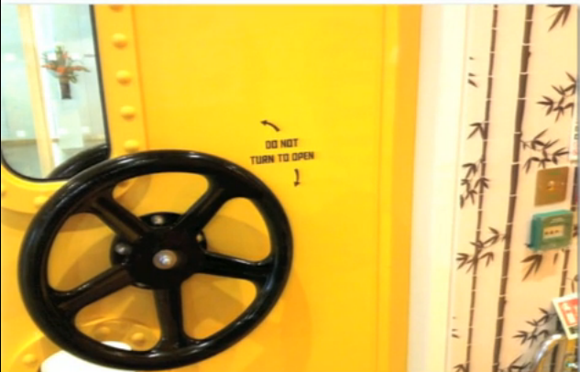
Bad Affordance
19

Slide 20
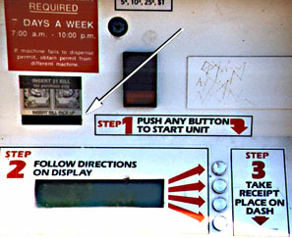
Why is this vending machine so bad?
Need to push button first to activate reader
Normally insert bill first before making selection
Contravenes well known convention
From: www.baddesigns.com
20
Notes:
20

Slide 21


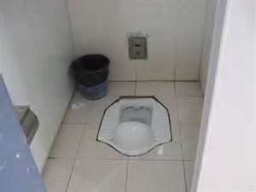
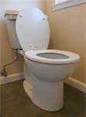

Physical affordances
    How do the following physical objects afford? Are they obvious?
21
Notes:
21

Slide 22

22

