Slide 1
Gestalt Principles
The whole is more than the sum of its parts

Slide 2

Law of Proximity
The principle of proximity states that, all else being equal, perception tends to group stimuli that are close together as part of the same object, and stimuli that are far apart as two separate objects. This allows for the grouping together of elements into larger sets, and reduces the need to process a larger number of smaller stimuli. For this reason, people tend to see clusters of dots on a page instead of a large number of individual dots. The brain groups together the elements instead of processing a large number of smaller stimuli, allowing us to understand and conceptualize information more quickly.

Slide 3
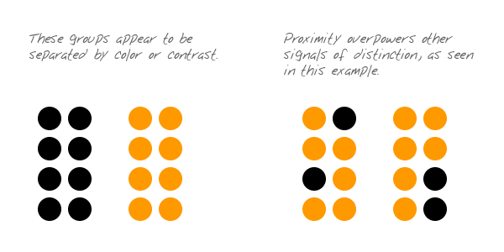
Proximity so strong it overrides similarity

Slide 4
Activity: Find the price of a double room at the Holiday Inn in Bradley
Notes:
4

Slide 5
Activity: Find the price for a double room at the
Quality Inn in Columbia
Notes:
5

Slide 6
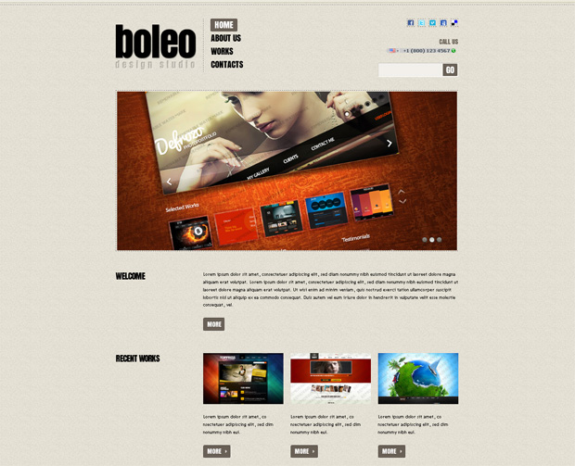
Example: Proximity

Slide 7
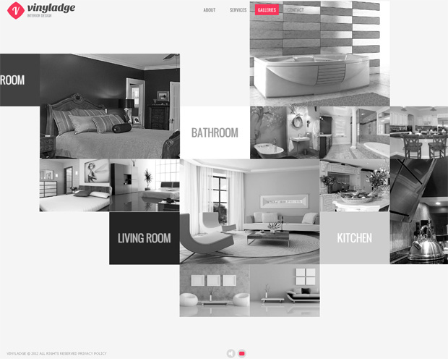
Example: Proximity

Slide 8

Example: Proximity

Slide 9
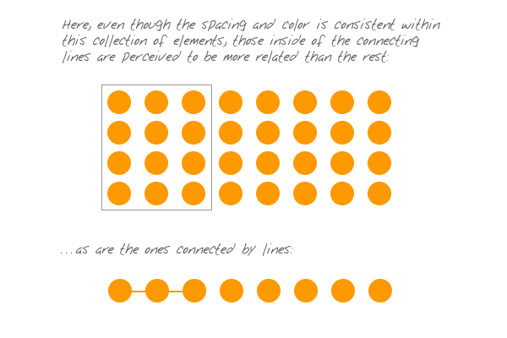
Uniform Connectedness
The principle of uniform connectedness is the strongest of the Gestalt Principles concerned with relatedness. It refers to the fact that elements that are connected by uniform visual properties are perceived as being more related than elements that are not connected. As with the principle of proximity, uniform connectedness causes us to perceive groups or chunks rather than unrelated, individual things.

Slide 10

Examples
One might think that tabbed navigation is most effective because of our familiarity with the physical and conceptual idea of a filing folder, but the fact is more basic. The filing folder works because of the principle of uniform connectedness.

Slide 11
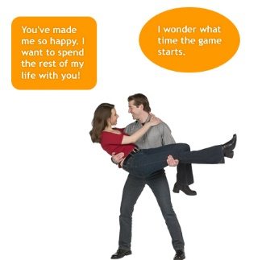
What could make this better?

Slide 12
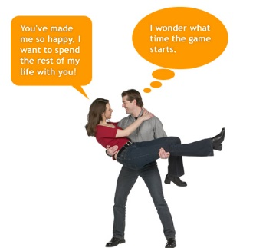
The lines help to connect

Slide 13
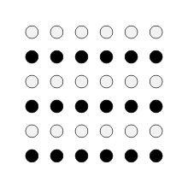
Law of Similarity
The principle of similarity states that, all else being equal, perception lends itself to seeing stimuli that physically resemble each other as part of the same object, and stimuli that are different as part of a different object.
This allows for people to distinguish between adjacent and overlapping objects based on their visual texture and resemblance.
Other stimuli that have different features are generally not perceived as part of the object. Our brain uses similarity to distinguish between objects who may lay adjacent to or overlap with each other based upon their visual texture.

Slide 14

Example: Similarity

Slide 15

Example: Similarity

Slide 16

Example: Similarity

Slide 17
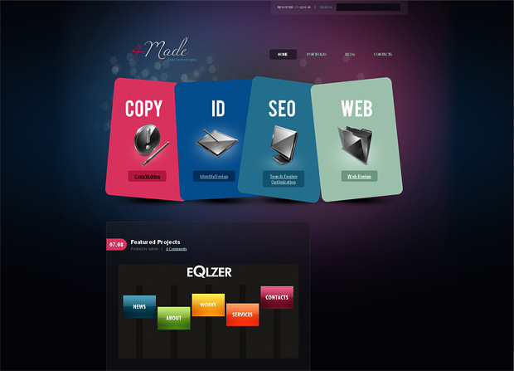
Example: Similarity

Slide 18
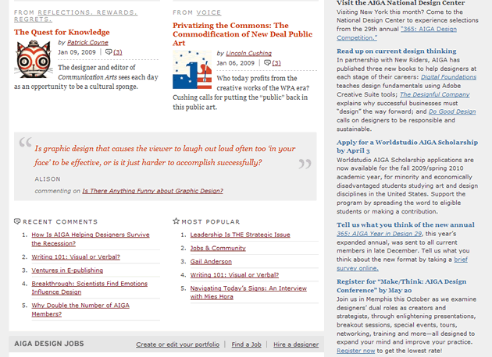
What items are similar/dissimilar?

Slide 19
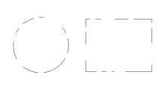
Law of Closure
The principle of closure refers to the mind’s tendency to see complete figures or forms even if a picture is incomplete, partially hidden by other objects, or if part of the information needed to make a complete picture in our minds is missing.
For example, if part of a shape’s border is missing people still tend to see the shape as completely enclosed by the border and ignore the gaps. This reaction stems from our mind’s natural tendency to recognize patterns that are familiar to us and thus fill in any information that may be missing.

Slide 20
Better definition
When looking at a complex arrangement of individual elements, humans tend to first look for a single, recognizable pattern.
LOOKING AT THE WHOLE instead of the individual parts

Slide 21
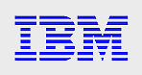


Logo Examples

Slide 22
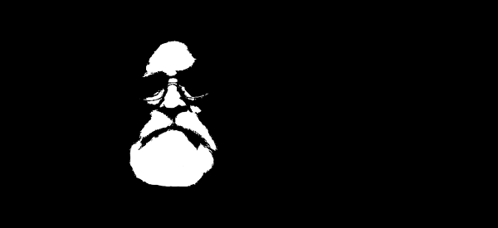
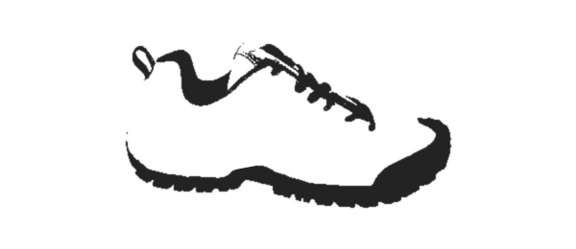
Image Examples

Slide 23
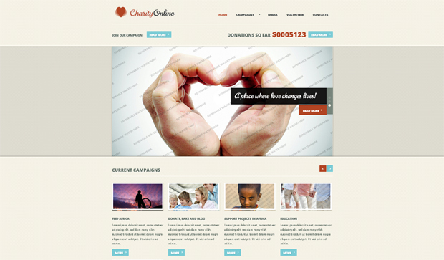
Visuals on Web: Closure

Slide 24
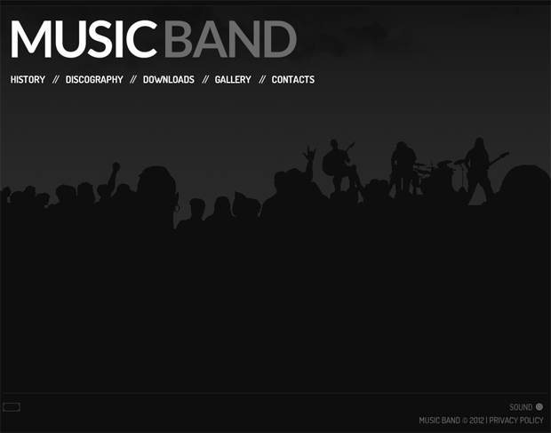
Example: Closure

Slide 25
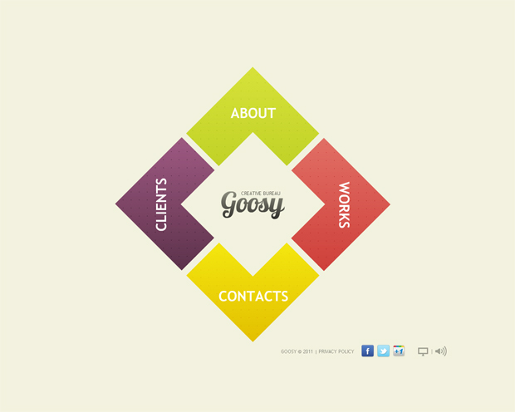
Example: Closure

Slide 26
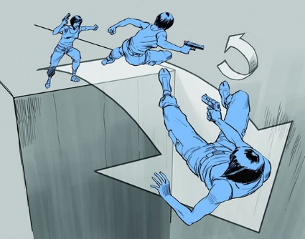
Finishing the story

Slide 27
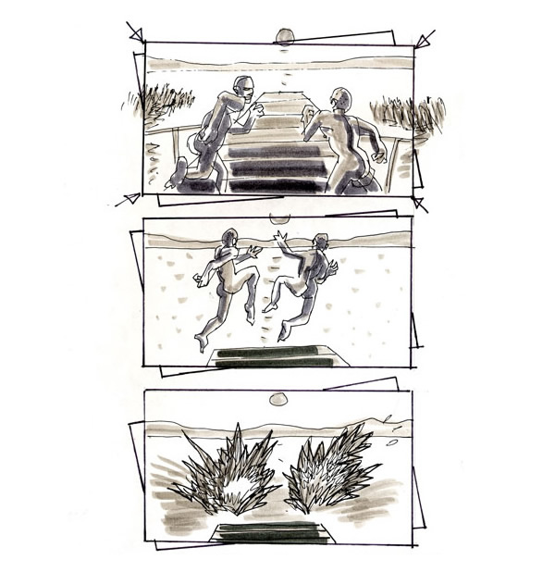
Finishing the story 2

Slide 28
Besides the visual…
Th prchas of a hme s lkely th sngle mst mprtant fnancl dcisn y’ll evr mke.
1, 3, 5, __, 9
There once was a man from Nantucket…
Why didn’t he call last night? He wanted to go to the concert. That girl tweeted from the concert. His friend liked her FB post too. [He must have gone to the concert with that girl.]

Slide 29
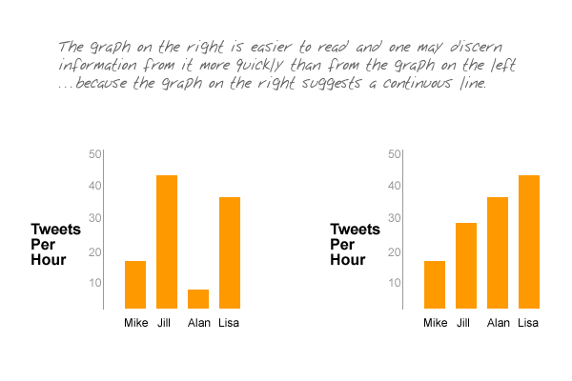
Along the line

Slide 30
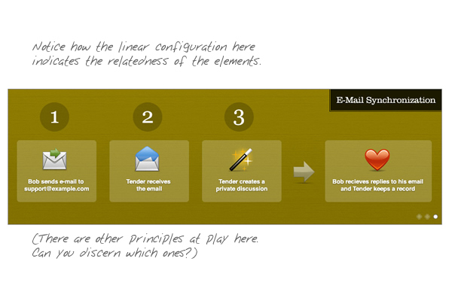
Along the line

Slide 31

Law of Good Continuation
When there is an intersection between two or more objects, people tend to perceive each object as a single uninterrupted object. This allows differentiation of stimuli even when they come in visual overlap.
We have a tendency to group and organize lines or curves that follow an established direction over those defined by sharp and abrupt changes in direction...

Slide 32
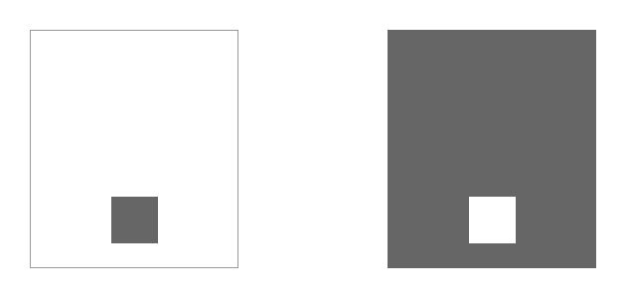
Figure and Ground
Elements are perceived as either figures (distinct elements of focus) or ground (the background or landscape on which the figures rest).

Slide 33

Example: Foreground/Background

Slide 34

Example: Foreground/Background

Slide 35
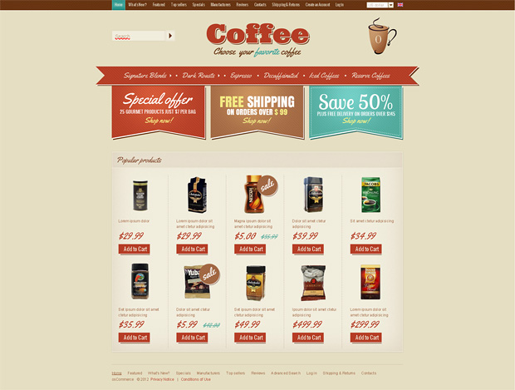
Example: Foreground/Background

Slide 36
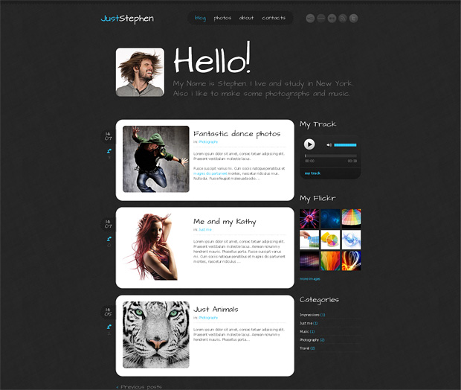
Example: Foreground/Background

Slide 37
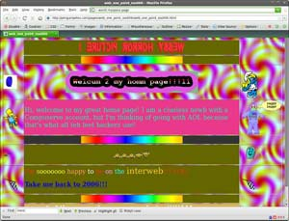
Example: Foreground/Background

Slide 38

Which is better and why?

Slide 39
More on the “why”
Regarding the examples above, one is successful and easy to understand and one is too complex to be effective.
The two navigation arrays are identical in composition, but the one the left is quickly perceived to be text content (figure) resting on almost inconsequential background shading (ground).
The array on the right is perceived as twice as many figures, since the structure and the content are composed of lines. In this case, lines are perceived to be content, so the structure competes with the content. The result is ugly and distracting.

Slide 40

Remember our design principle of AFFORDANCE?
Which looks more like something you would click?

Slide 41
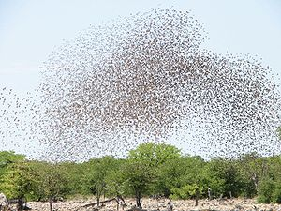
Law of Common Fate - a flock of birds.
When visual elements are seen moving in the same direction at the same rate, perception associates the movement as part of the same stimulus.
For example, birds may be distinguished from their background as a single flock because they are moving in the same direction and at the same velocity, even when each bird is seen - from a distance - as little more than a dot. The moving 'dots' appear to be part of a unified whole.
This is ESPECIALLY useful with active elements such as menus or banners

Slide 42

Example: Common Fate
We assume all of the menus will act the same.

Slide 43
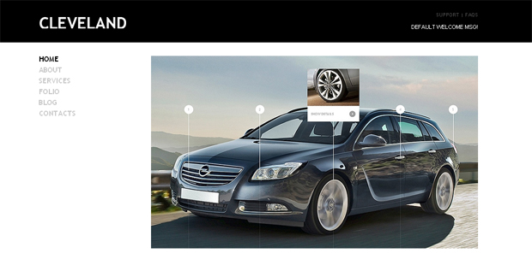
Example: Common Fate
Car is pointing left so it looks like we should click to the left.

Slide 44
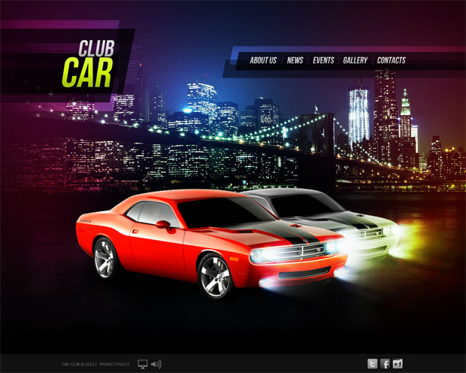
Example: Common Fate
Car is pointing right so we will tend to look to the right.

Slide 45
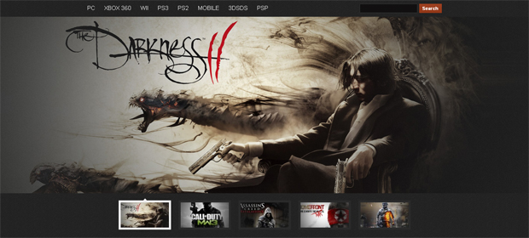
Example: Common Fate
Man transitioning in background is moving left but looking downward as his weapons – we want to start clicking down and left.

Slide 46
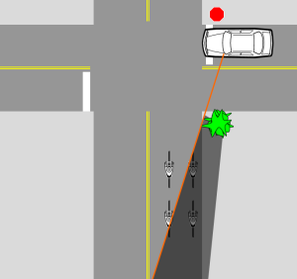
In the wild example
Motorcycles seen as flocks instead of individual riders
I want to turn right.
I am turning left
I am going straight.

Slide 47

Good Form (aka Symmetry )
The principle of good form refers to the tendency to group together forms of similar shape, pattern, color, etc. Even in cases where two or more forms clearly overlap, the human brain interprets them in a way that allows people to differentiate different patterns and/or shapes.
An example would be a pile of presents where a dozen packages of different size and shape are wrapped in just three or so patterns of wrapping paper.

Slide 48
The Grid
When designing a web page, we designers will usually employ a mechanism that facilitates good continuation: the grid.
A grid is most useful in bringing order to a layout, but it also is useful in indicating context.

Slide 49
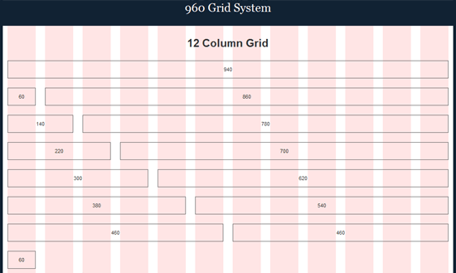
Example: Symmetry

Slide 50

Example: Symmetry

Slide 51
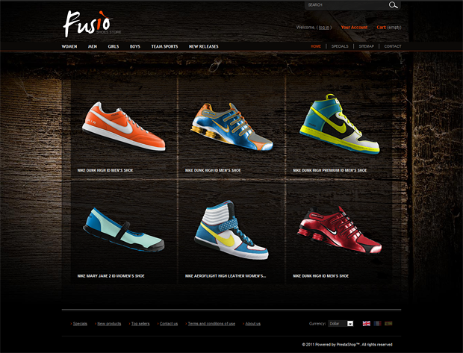
Example: Symmetry

Slide 52

Example: Symmetry

Slide 53

Horizontal Symetry

Slide 54

Vertical Symetry

Slide 55
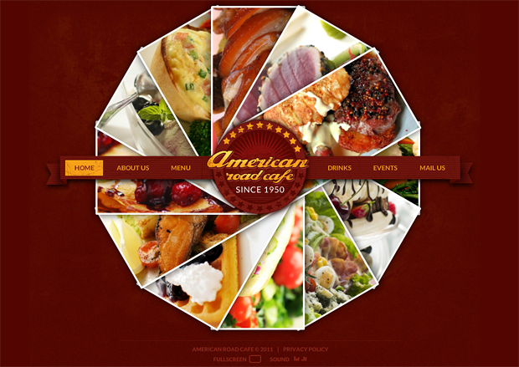
Example: Radial Symmetry

Slide 56
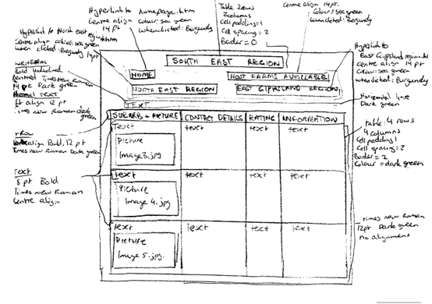
When sketching or wireframing it is good to start with silhouettes

Slide 57
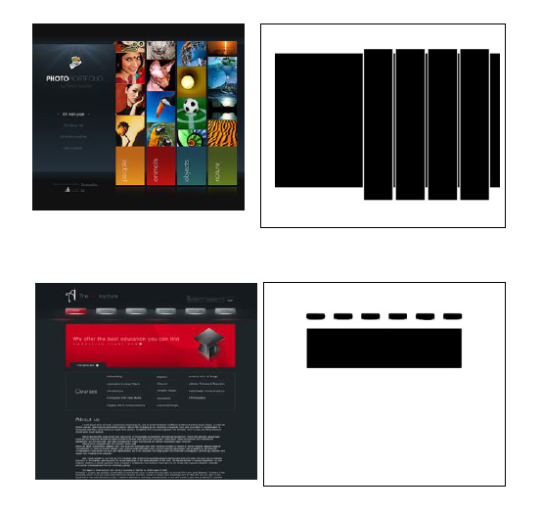
Silouettes

Slide 58
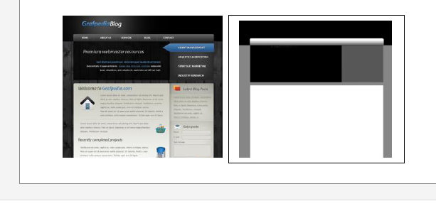
Proximity - similarity - continuity

Slide 59
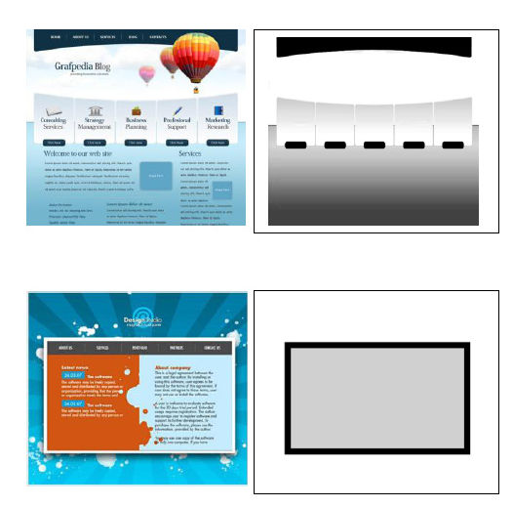
Foreground and background

Slide 60
Gestalt Illusions

Slide 61
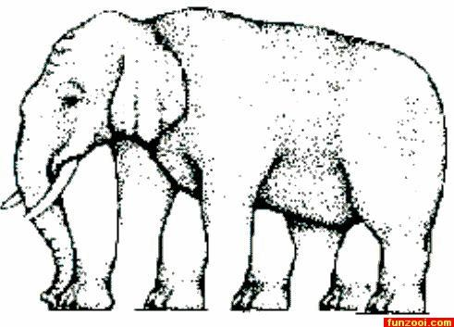

Slide 62


Slide 63
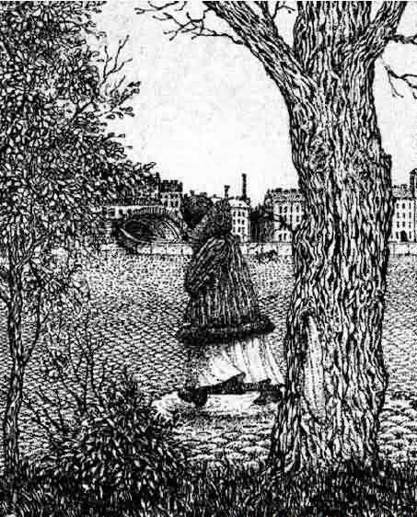
pareidolia

Slide 64


Slide 65
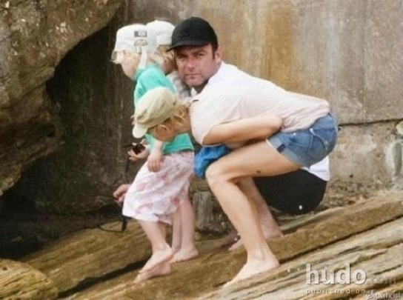

Slide 66
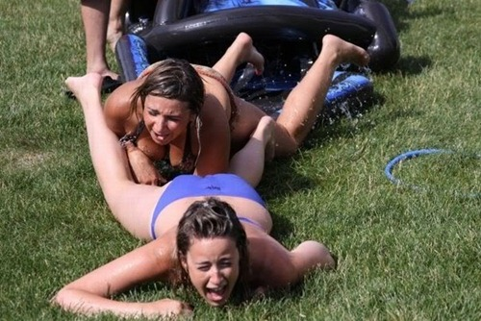

Slide 67

Questions?

