Slide 1
Facilitator Best Practices
Contact Center Learning & Development

Slide 2
Being Prepared
Read and rehearse the guide content so delivery is fluid and transitions are smooth
Meet with tech person the week before class to ensure set-up of equipment (dual screen monitors, etc)
Arrive, at minimum, 30 minutes prior to start of class.
Be prepared – looking rushed, disorganized, or not knowing the material makes you seem vulnerable/unconfident
If using a PowerPoint, have the first slide showing on the overhead before class participants arrive
Access/login all applicable systems (e.g. NESP3, Navigator, KUBRA, click2KNOW) before class begins
Have all necessary supplementary materials (e.g. in-class practice mock calls) printed before class begins
Go “Do Not Disturb” on IM/Skype/Teams

Slide 3
Setting Expectations
Review Classroom Expectations at the beginning of the class
Hold participants accountable
Ensure cell phones are put away (unless there is an emergency)
Instruct trainees to go “Do Not Disturb” on IM/Skype
Be consistent - Don’t make exceptions for some people while holding others accountable
Tell folks there will be a 5-7 minute mini break each hour so they don’t ghost out of the room (make accommodations for medical issues)
Ensure participants are not browsing the internet or using IM/Outlook (unless instructed) during lecture and activities
Expectations should be the same for all participants
Be the behavior you want to see
If it is expected that learners not text/play on their phones, don’t text/play on yours
Avoid playing around on your computer/laptop during class time (applies to all trainers in the room, not just the lead trainer)
Do not use jargon terms; always model customer-friendly language

Slide 4
Body Language and Attitude
Greet participants with a clear upbeat voice
Greet people by name to establish presence and to identify people as individuals
Use positive body language
Face the learners (this is especially important when using the projection screen. Do not turn your back on the learners when gesturing to the screen and do not block the screen with your body)
Keep your arms uncrossed and relaxed and avoid using barriers, such as a podium. This signals you don’t want to make contact or makes you seem unapproachable.
Make eye contact
Smile (without gum, candy, etc. in your mouth)
Be aware of your facial expressions
Greet participants with a clear upbeat voice

Slide 5
Where to stand
Flex between podium and walking around the room among participants
Use the whole classroom – walk around when instructing, stand in the back of the room when using the projection screen to view demonstrations/videos, circulate the room to make yourself available for questions while learners are working in groups or independently.
Stand up to teach. Use wireless keyboard and mouse from different locations in the room. Do not sit at computer in the front of the room.
Face the learners when they need to pay attention to you. Try to not turn your back to the learners when gesturing to the overhead
Go behind the learners when presenting interactive labs or lessons so the facilitator can observe what participants are doing on monitors and help as needed

Slide 6
Provide quality feedback
Reinforce “good to great” behaviors/skills
Provide specific praise that reinforces behaviors/skills you would like to see repeated
Provide specific information that corrects behavior/skills you would NOT like to see repeated

Slide 7
Maintaining Order
Use proximity, gestures and verbal cues to maintain order in the classroom
Do not enter into a power struggle/confrontation
Address issues individually, not in front of the whole group
If the issue persists, then involve the supervisor

Slide 8
Feedback
Immediate feedback from the instructor: Items such as labs, guided learning, and room activities
Self-check feedback: Items such as an answer sheet that peers fill out for peer mock calls that are given back to the participant that they can self-check when the facilitator’s debrief the correct answers
Qualitative and Quantitative feedback for scored Mock Call: These are scored by Trainers, Supervisors, or Quality Assurance (QA) personnel. They will include detailed feedback comments both with positive information and areas for improvement. They will utilize the existing QA score form. This may take overnight or longer to do depending on # of students.
Training feedback: Once per week during training the participant meets with their Trainer and Supervisor to get feedback on their training performance and can share information on items they would like to know more about as well as receive additional help

Slide 9
Language
Each business area has its own set of terms comprised of meaning, spelling and proper usage.
In the context of the course, provide glossary or reference to definitions or explanations of the vocabulary.
Use active instead of passive voice

Slide 10
Look & Feel & Pattern
Look
Capitalize the first word in bulleted lists
Color palette
Images
Layout
Font (Use San-Serif, i.e.-Arial, Calibri, Articulate, etc.)
Overall styling
https://www.countryfinancial.com/en/styleguide/atoms/global/colors.html
Feel
Same rhythm or format
Learning Objectives introduced at the beginning of the module
Customer Interaction behavior/expectations throughout the course
Breaks
Office hours

Slide 11
Parking lot
“I don’t know but I can look into it.”
The syllabus is organized so items are delivered in a specific order and a cadence. Sometimes there are items that may not fit in the flow. We want to be flexible to the class and be able to adapt. Add items to the parking lot page.
Use these for questions you cannot answer right away
Use for rabbit hole deep dive explorations that you do not have class time for
Use these for items the class would like more coverage on
Some questions, have the student go find the answer and then present to the class what they find
Encourage participants to write their questions on a post-it note during lecture

Slide 12
Disrupters
Establish order in the classroom and take control by directing participants to pay attention to the activity or give the group something to do
Give the disrupter a task to keep them busy such as looking up parking lot items
If continual performance/behavioral issue occurs:
Address issue privately with individual
Observe performance/behavior afterwards
If performance/behavioral issue continues, involve supervisor
Follow the struggling student guidelines to ensure fairness across individuals

Slide 13
Communication
Do a daily check-in at either beginning of class, end of class, or at a specific break per day with team, Sup, and whoever else needs to be in the loop
Make sure your team is aware of medical, emotional, disrupters, performance, and where we are in the class content
Make sure tech person is aware of overall and individual technical issues as well as changes in schedule when accessing systems
Make sure L&D Supervisor is aware of team, tech, and performance issues
Make sure the participant Supervisor is aware of classroom performance, issues to observe or address, and any needs for additional intervention
For struggling students please follow the struggling student guidelines so each person each class is treated the same (and helps ensure equal treatment)

Slide 14
Participants who are late or miss class
The participant will be responsible to make up time for class they have missed.
For new hire classes, participants should have their Supervisor contact ( cell phone number) for emergency situations only (illness, death in the family, etc)
Office hours should be available to all students. Make sure these are announced the first day of class. They can be the hour before class, hour after class, or specific times during the week
Office hours can be optional or can be prescribed by the participant’s Supervisor
Tutoring is offered to students who miss class. This is one-to-one and requires additional resources

Slide 15
Tech Prep & Issues
Test necessary training systems first thing in the morning when arriving to the office, and keep co-trainer/team up-to-date with unexpected downtime
If possible, have your training assistant, tech support, or Supervisor fix technical issues so that you can continue with facilitating
When using the computer for something other than instruction (i.e. troubleshooting issues), mute the screen on the LCD projector
Keep tech support/Supervisor/team informed of technical issues

Slide 16
Co-Trainers
Determine
Who is doing what BEFORE the training session
when facilitation responsibility shifts between lessons
where the co-trainer will be when the facilitator is in front of the group
Who is scoring activities and mock calls
Who is helping participants set up during mock calls
Who is helping in the classroom for labs
Who is working with tech support

Slide 17
Facilitator tasks
For Prep, team lead is responsible for
the checklist of all prep work
communicating with the participants/supervisors before class
setting up the room (flip chart paper, post-it notes, pencil boxes, etc)
Responsible for notes
Responsible for uploading all necessary documents/activities to applicable class fileshare location
Schedule all appropriate meetings (e.g., Friday Feedback w/Supervisors) and meeting rooms before class begins
During class
Main facilitator of classroom content
Responsible for maintaining positive classroom environment
Identify and communicate to co-trainer less proficient learners
Monitor learning lab activities
Helps evaluate mock calls and distributes feedback
Monitor the classroom during activities/learning labs. If participants finish early, lead facilitator should provide additional instruction to keep learners engaged (e.g., reviewing click2KNOW for additional procedures)
Communicating suggestions or updates to click2KNOW

Slide 18
Co-Facilitator or Assistant tasks
Assist the trainer in facilitating session
Communicates technical issues via Comm Center/tech support
Observe the learning process to determine how well learning goals are being met
Add relevant points to discussion
Clarify points
Monitor learning lab activities
Help answer questions/resolve learner issues or needs
Ask questions lead trainer may have overlooked
Distribute materials/handouts
Identify and assist less proficient learners
Evaluates mock calls and distributes feedback
If lead trainer is answering how-to questions, use computer to model transaction as question is being answer
Assist the lead Facilitator as requested (e.g., roaming the room during activities/mock calls to help answer questions)
Responsible for researching “Parking Lot” questions
Resolve technical issues via Comm Center/tech support during class
Add only relevant points to discussion (do not overwhelm the participants with information…teach “to the middle”)
Grade Learning Lab/Activities/Mock Calls, and provide constructive feedback to all participants
Ex: If a participant missed a question on an activity, tell them why they were incorrect..where should they have gone to get the correct answer? Etc
Partner with Lead Facilitator to complete in-class scenarios while demonstrating applicable CARES behaviors
Document participant questions that may require follow-up, but are not necessarily “Parking Lot” questions
Meet with Lead Facilitator during breaks/lunch/after class to discuss necessary changes needed (i.e. lesson went long and content had to be cut – what’s the plan moving forward?)

Slide 19
Be flexible
System issues
Have backup plans in case the systems go down or a simulation is not working
Content may shift to different days/times
Different class abilities
Some classes may need more time to cover a topic than others

Slide 20
Struggling Student tools
Office Hours
An hour before or after class Instructor led
Participant signs up via email
Needs to be approved by Supervisor
Supervisor does shift differential for any paid time
Tutoring
When someone misses part, all, or more than one class
Used to review content already covered or to get exposure to content from missed class
Participant is assigned to meet with an individual who is not the instructor
Self‐Help
Can come in early or stay late to practice on their own
Policies/data may need to be reset to be re‐used
Participant signs up via email
Needs to be approved by Supervisor
Floor Observations
Not during class time
Participant signs up via email
Needs to be approved by Supervisor
Supervisor will arrange for people they can observe with
Deliverable write‐up needs to be done by the participant outlining what goals they have and what their outcomes were
Tech person is contacted for any Y cables etc.

Slide 21
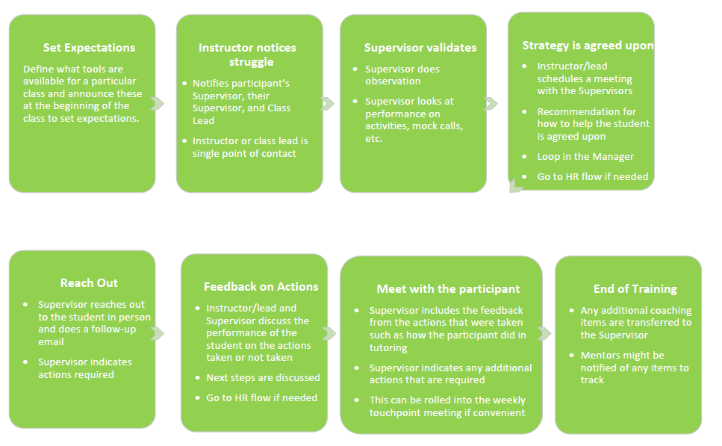
Struggling Student flow – no HR

Slide 22
Struggling Student flow – with HR

Slide 23
Don’t be a buddy
You might be teaching people that you have a family or social connection to
You might be teaching people that you were formerly a peer to
Make sure you establish that you are the trainer and not the buddy.
Spell out to them that your relationship outside the classroom is different

Slide 24
Cognitive considerations
Resetting mental clocks
Lecture should not surpass 20 minutes before a change in activity takes place.
Standing up or moving around helps to reset mental clocks if sitting too long
Formative assessment
When a participant “forms” a question or statement, they use different parts of their brain and can “assess” or analyze what they are saying/doing
An example is when you can’t think of a word, you go ask someone, and while you are asking them, the solution comes to you.
WE REMEMBER …
10% of what we read
20% of what we hear
30% of what we see
50% of what we see and hear
70% of what we discuss with others
80% of what we personally experience
95% or what we teach others
- Edgar Dale (Cone of Experience)

Slide 25
Learning Styles
Verbal/Narrative: Lectures or having portions of the lesson that tell a story. Ex: Bill is away on military tour and his brother Phil needs to make payments on his policy while he is away.
Visual/Spatial/Flow: Mental models or physical examples
Kinesthetic hands-on: Going through the example step by step Ex: Mock calls with a live caller
Social: Learning in a small group. Ex: Think-pair-share with small group activities, peers doing parts of the lecture, peers helping with the role playing in the in-class scenarios, wheel of fun, etc.
Navigator
Policy
Image
Coverage

Slide 26
Promote learner engagement
Maintain positive attitude and high energy
Regain focus if attention is lost
Change speaking volume to promote engagement
Ask open ended questions and engage learners in dialog about the topic
Allow all learners an opportunity to participate
Use tactics to limit those who over-participate
Vary your question/answer techniques (how you’re calling on learners)

Slide 27
Observing cues from participants
Being a trainer is more than reading from notes – observe non-verbal cues and flex to them as needed
Be receptive to feedback and questions. There are no “dumb” questions.
If a participant asks a question in which the facilitator does not know the answer, the participant should write the question on a post-it, and place it on the “Parking Lot”/White board for further research. Do not dismiss questions in which the answer is unknown – facilitator should clarify additional research is needed
Be sure to answer all applicable questions when closing one lesson and moving to another
Regain focus when attention is lost – the facilitator should be in command of their classroom, and not the participant’s “friend”
Maintain positive attitude and high energy, especially during system downtime or when “issues” occur in the classroom
Allow all learners an opportunity to participate
Use tactics to limit those who over-participate
Do not dominate the conversation

Slide 28
Engagement
Have participants demo items – you don’t always have to be the person in the front of the room!
Call people to the front
Don’t force them if they really don’t want to do it

Slide 29
Adult learners
Remember that the participants are adult learners (andragogy):
Adults have a need to be self-directing and self-exploring
Adults have more experience than youth, and want to reflect on that experience in their current and/or future work role
Adults become ready to learn when they know the “why” behind their learning
Adults want to learn best when they have a sense of ownership in their learning
Adults are motivated by both extrinsic and intrinsic forces. The most potent motivations are intrinsic (e.g., self-esteem, growth, broader responsibilities)

Slide 30
Individual Differences
Find their individual strengths
target these items
high level learners - give them a challenge
other people who are still working - work with them individually

Slide 31
Trust your team
they are there to help
you don't have to do everything
you are not a burden when you are getting help

Slide 32
Virtual best practices
These guidelines are still being established and are tied to the channel you use (such as TEAMS, AdobeConnect, camera on laptop, camera in training room, etc.)
Virtual attendees should see what you want them to focus on whether it is the facilitator, a shared screen, or a video.
Make sure to do an audio and video check before class begins
Engage people as individuals
Utilize system tools such as polling to keep everyone engaged
Have people type in answers in the chat versus dealing with audio issues and microphones

Slide 33
Food
Food days at the beginning or end of training can be a good idea – don’t go too overboard. You are not required to do this and it is only out of the goodness of your heart and your own pocketbook
Make sure you coordinate with the other trainers and supervisors who is bringing food so you do not duplicate
If participants are interested, pick a potluck day like on a Friday review or when there are not high stakes
Having a small bowl of candy can be a nice option to have in the classroom during breaks

Slide 34
Structural/File Management
CSC/Billing BP file area should include:
Follow Contact Center Training file structure (TEAMS)
Follow naming conventions for document structure
Course Materials
Facilitator Guide
Archive
Dated course facilitator guides
Remove from working folder

Slide 35
More on how to be a good trainer
Follow Industry Best Practices based on ATD Research: https://www.td.org/education-courses/search-all-programs

Slide 36
Questions?

